Slide 1

Higher education beyond the enrollment cliff: What are we facing?
Panelists include:
Ms. Lisa Branson, Sr. V.P. of Client Development, enrollmentFUEL
Mr. Bill De Baun, Sr. Director of Data & Strategic Initiatives, National College Attainment Network (NCAN)
Facilitator: Lisa Talbot, Director of Development, Sallie Mae
March 20, 2025, from 1-2 PM

Slide 2
Brought to you by the VASFAA Membership Engagement Committee
Who we are: Small committee who plans and executes membership engagement activities, including such things as training events, professional development activities, and other activities to keep VASFAA membership engaged, informed, and connected.
Committee members include:
Marie Johnson, Director of Student Financial Services, University of Vermont (Co-Chair)
Lisa Talbot, Director of Business Development, Sallie Mae (Co-Chair)
Lynda Ossola, Communications Coordinator, University of Vermont
Jeanie Stella-Devani, Assistant Director of Financial Aid, Vermont State University
Melaney Wald, School Services Representative, Vermont Student Assistance Corporation

Slide 3
Agenda
Introductions & welcome
FAFSA data – another potential enrollment indicator
What is the “Enrollment Cliff”?
Unpacking the Enrollment Cliff
Are there ways to combat “The Cliff”?
How America Pays for College – what’s driving student enrollment decisions
Questions

Slide 4

HI, IT’S GREAT TO BE HERE!
Please reach out if I can help!
Bill DeBaun
Senior Director, Data
and Strategic Initiatives
NCAN
debaunb@ncan.org

Slide 5
FAFSA
Notes:
Five-letter acronym that makes people say four letter words
FAFSA completion matters because going to college matters
Equity in FAFSA completion matters because equity in going to and attaining a postsecondary degree or credential matters
FUTURE Act – 2019, FAFSA Simplification Act, 2021
Someone else dug this hole for you, but it’s our job collectively as a field to help students climb out

Slide 6
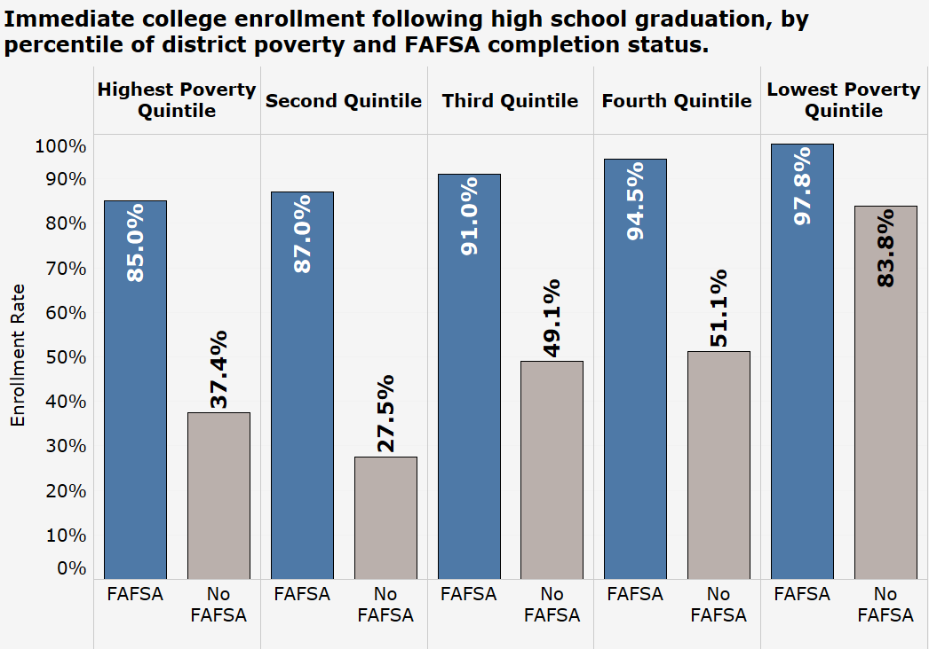
WHY
FAFSA COMPLETION MATTERS
SO
MUCH
Source: NCAN analysis of High School Longitudinal Study: 2009 data

Slide 7
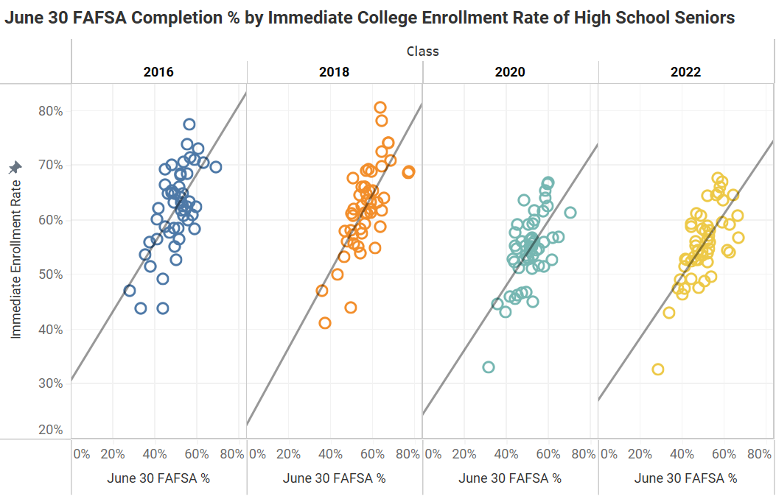
WHY
FAFSA COMPLETION MATTERS
SO
MUCH
Source: NCAN FAFSA Tracker; NCHEMS HigherEdInfo.org

Slide 8
FAFSA COMPLETION
CAN BE the canary in the coal mine
High School Class | National FAFSA Completion Rate | Year-Over-Year FAFSA % Change | National First Fall Enrollment Rate
2018 | 54.0% | +1.9% | 64%
2019 | 53.8% | -0.5% | 62.9%
2020 | 52.0% | -3.7% | 59.9%
2021 | 49.9% | -4.8% | 58.8%
2022 | 52.1% | +4.6% | 60.0%
2023 | 53.4% | +1.3% | 60.2%
2024 | 46.0% | -11.6% | +3.4%**
Source: NCAN FAFSA Tracker, NSCRC HS Benchmarks Reports

Slide 9

THINGS THAT MAKE YOU GO

Slide 10
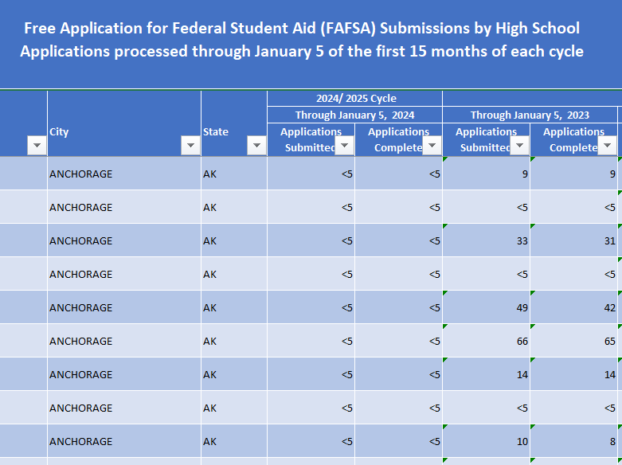
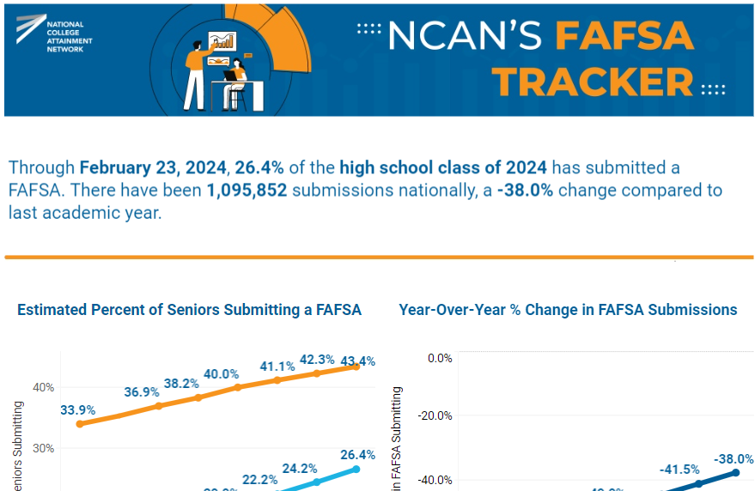
NCAN’s FAFSA Tracker transforms publicly-available, high school-level data into national, state, and local insights on FAFSA completion trends within and across years

Slide 11
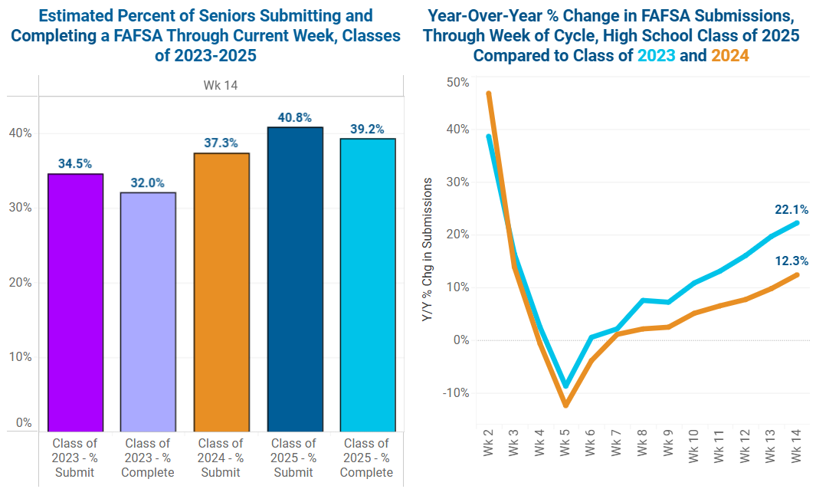

Slide 12
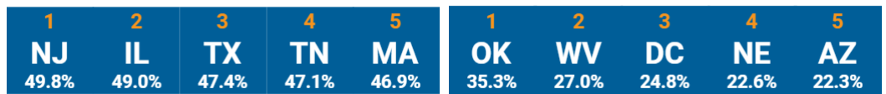
% OF SENIORS
COMPLETING A FAFSA
YEAR-OVER-YEAR
% CHANGE
15
VT
40.7%
10
VT
+16.7%

Slide 13
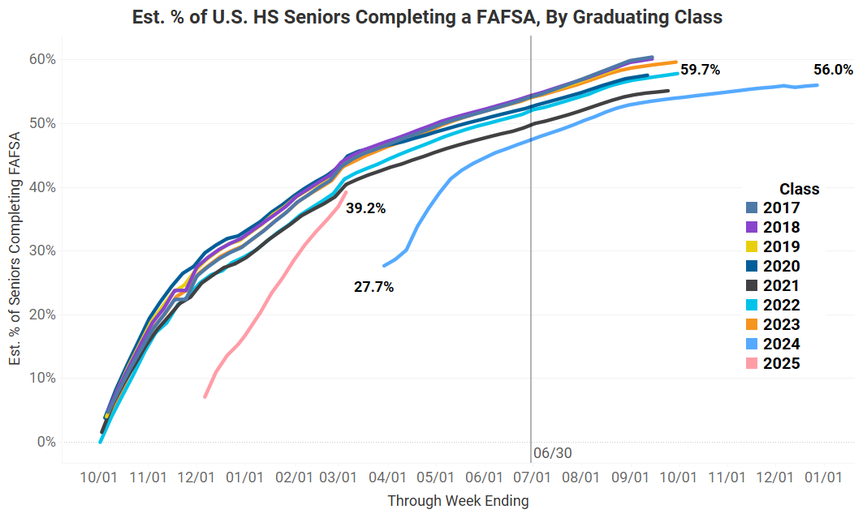

Slide 14
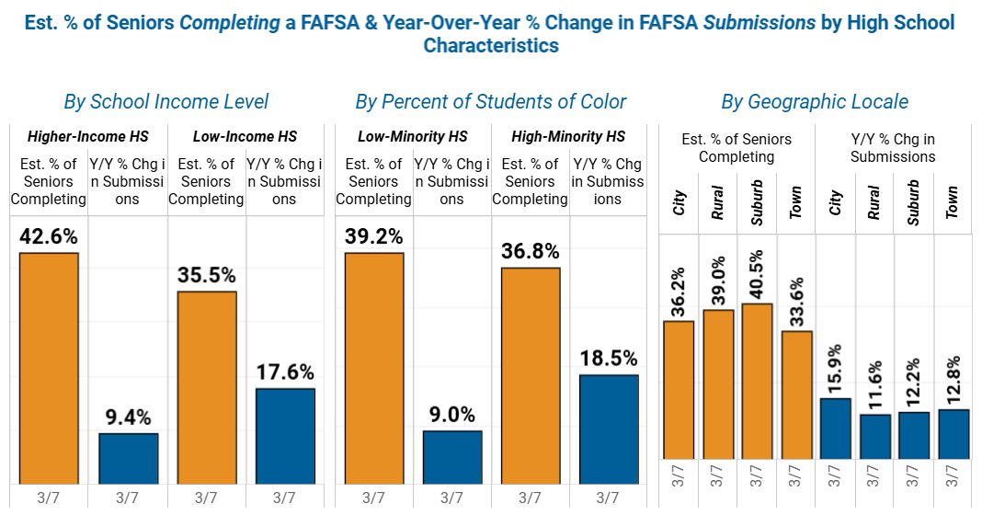

Slide 15
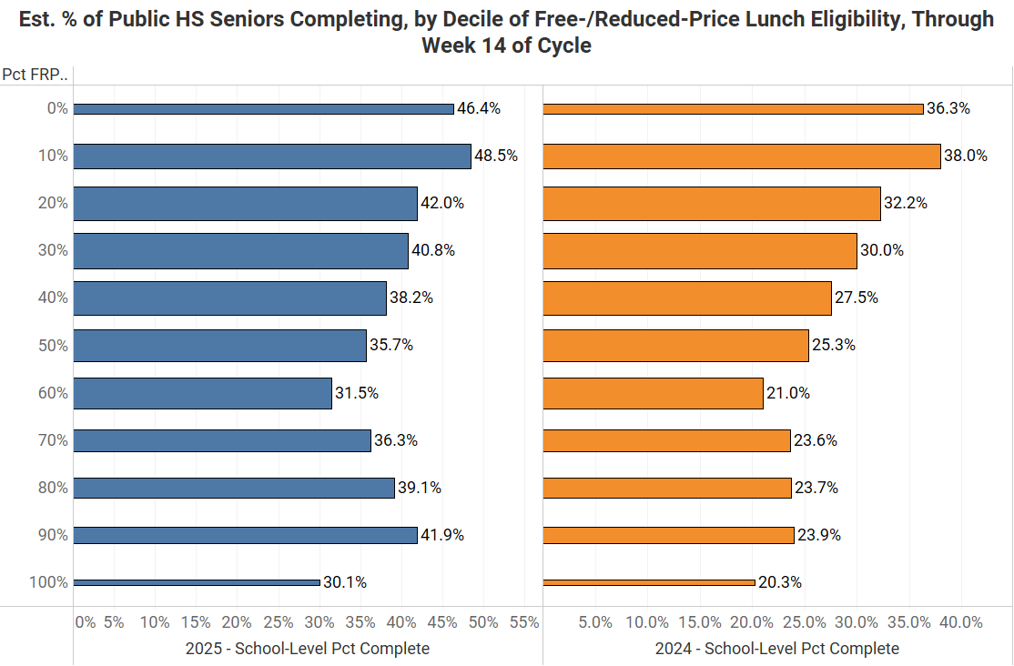

Slide 16
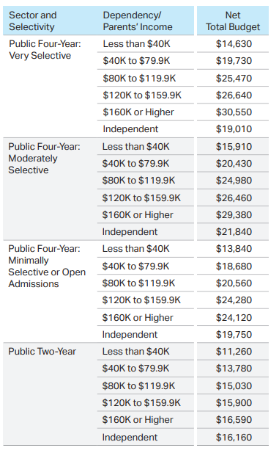
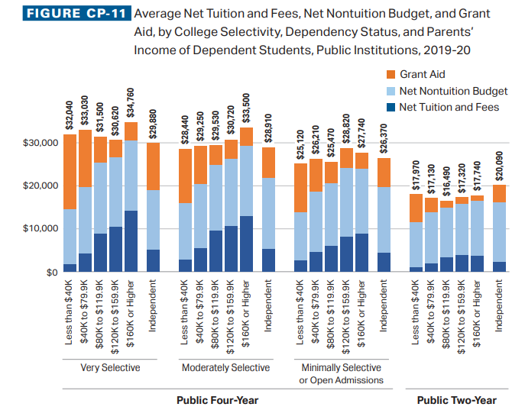

Slide 17
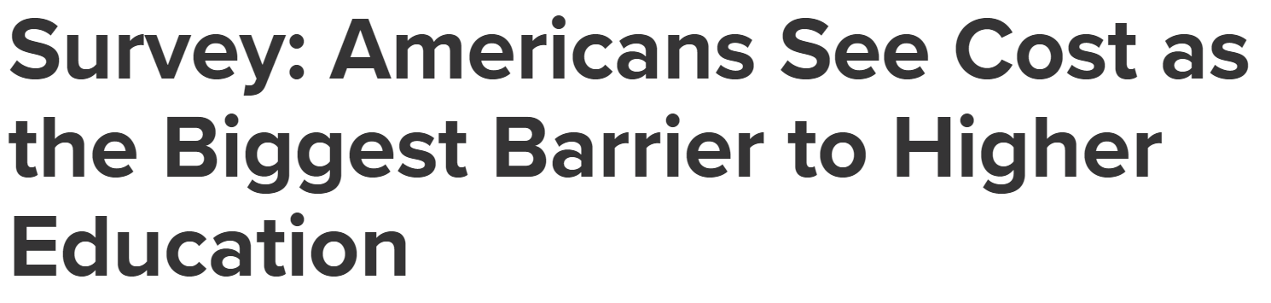
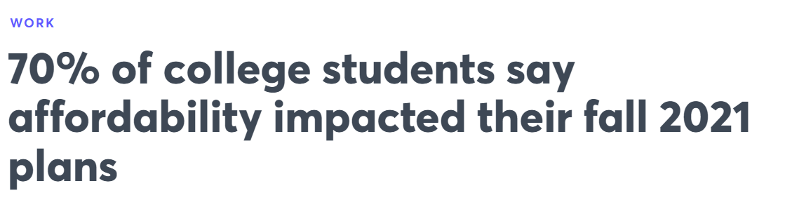
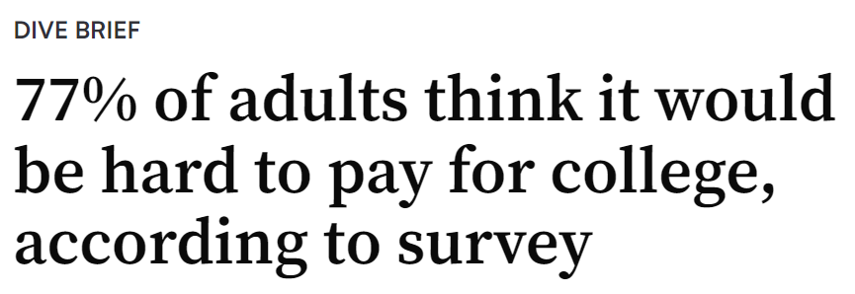

Slide 18
Parting Thoughts Before Passing Off
For most students, Fafsa COMPLETION (and advising to complete the fafsa) IS NECESSARY but not sufficient
How do universal fafsa policies change the value of fafsa completion as a leading indicator
There are 36.8 million some college, no credential students in the united states (nscrc)
The united states still does a poor job getting many traditional-aged students of color, students from low-income backgrounds, and first-generation college students into the pipeline in the first place

Slide 19

Understanding the Enrollment Cliff: TRENDS & IMPACT
Analyzing WICHE Data & Vermont Enrollment Trends
Lisa Branson, Senior Vice President of Client Development

Slide 20



What is the
ENROLLMENT CLIFF?
The "Enrollment Cliff" refers to the projected, sharp decline in college enrollments starting in 2025.
It was driven by declining birth rates post-Great Recession (2008).
Fewer high school graduates mean fewer traditional college students.

Slide 21

The Enrollment Cliff:
WHY IS IT HAPPENING?
Declining U.S. birth rates since 2008
Changing perceptions of higher education value
Economic shifts influencing career paths
Increased competition from alternative education and workforce options
WICHE (Western Interstate Commission for Higher Education) High School Graduation Data:
  National projections show a peak in 2025, followed by a decline
  Significant impact varies by region

Slide 22
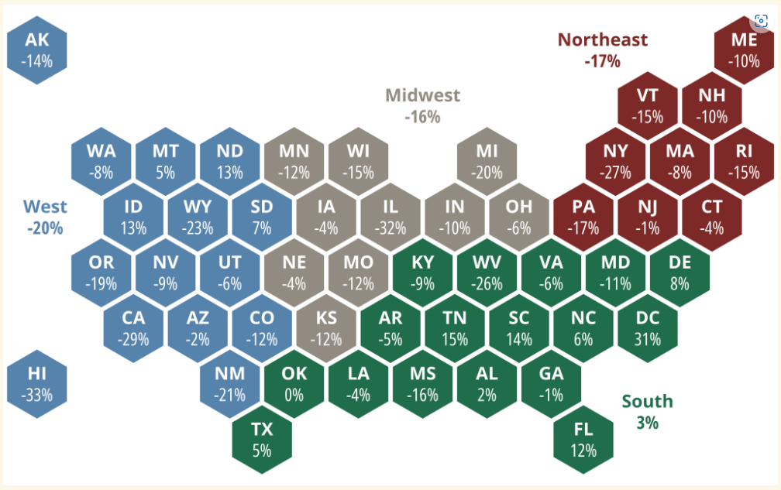
Unpacking the Enrollment Cliff
WITH DATA!
Vermont’s projected decline in HS Graduates is 15% by 2041.
Notes:
(Unpacking the Enrollment Cliff with Data)
Chart: Line graph showing WICHE’s projected U.S. high school graduate numbers (peak in 2025, then decline).
Chart: Historical college enrollment trend (steady growth until 2010, stagnation, then decline).
WICHE High School Graduation Projections
Source: Western Interstate Commission for Higher Education (WICHE)
Report: Knocking at the College Door
Link: https://knocking.wiche.edu
What to Look For:
National and state-level high school graduate projections (use the Vermont-specific data).
Graphs showing peak in 2025, followed by decline.
Historical U.S. College Enrollment Trends
Source: National Center for Education Statistics (NCES)
Dataset: Digest of Education Statistics
Link: https://nces.ed.gov/programs/digest/
What to Look For:
Tables showing historical college enrollment from 2000–present.
Breakdown by sector (public/private, 2-year/4-year).

Slide 23
Vermont High School Graduation
& COLLEGE ENROLLMENT TRENDS
Vermont HS graduation rates are declining.
  By 2041, rates are projected to decrease by 15% to 4,921.
Fewer Vermont students are choosing to enroll in college.
State-level policies and economic factors are influencing decisions.
Notes:
(Vermont HS Graduation & College Enrollment Trends)
Chart: Bar chart showing Vermont HS graduation rates over time.
Chart: Line graph comparing Vermont HS graduation rates vs. college enrollment rates.
Vermont High School Graduation & College Enrollment Trends
Source: Vermont Agency of Education & NCES
Link: https://education.vermont.gov/
NCES State Data: https://nces.ed.gov/datatools/
What to Look For:
Number of Vermont high school graduates over time.
College-going rates for Vermont students.

Slide 24
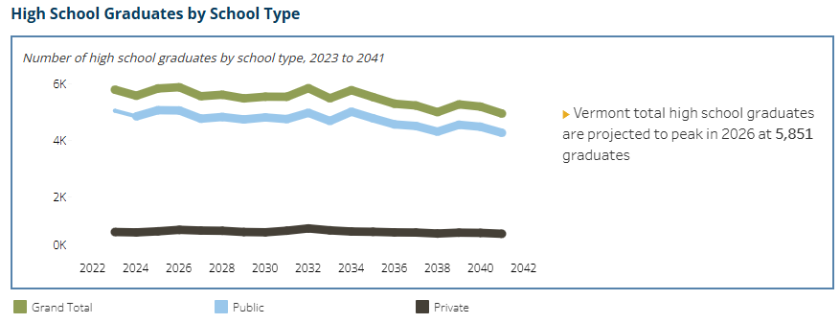
Vermont High School Graduation
& COLLEGE ENROLLMENT TRENDS
By 2041, the number of HS grads is projected at 4,921 for VT.
Notes:
(Vermont HS Graduation & College Enrollment Trends)
Chart: Bar chart showing Vermont HS graduation rates over time.
Chart: Line graph comparing Vermont HS graduation rates vs. college enrollment rates.
Vermont High School Graduation & College Enrollment Trends
Source: Vermont Agency of Education & NCES
Link: https://education.vermont.gov/
NCES State Data: https://nces.ed.gov/datatools/
What to Look For:
Number of Vermont high school graduates over time.
College-going rates for Vermont students.

Slide 25
Vermont College Enrollment:
RACE & ETHNICITY
Disparities in college-going rates by demographic group
Underrepresented groups facing barriers such as affordability, access, and preparedness
Large growth in Hispanic/Latino population (202%)
Black population up by 56%
White/Asian decrease by -20%+
Notes:
Vermont College Enrollment by Race & Ethnicity
Source: Vermont State Colleges, NCES, IPEDS
IPEDS Data Center: https://nces.ed.gov/ipeds/
What to Look For:
Enrollment breakdown by race/ethnicity over time.
Percentage of underrepresented students going to college.

Slide 26
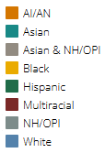
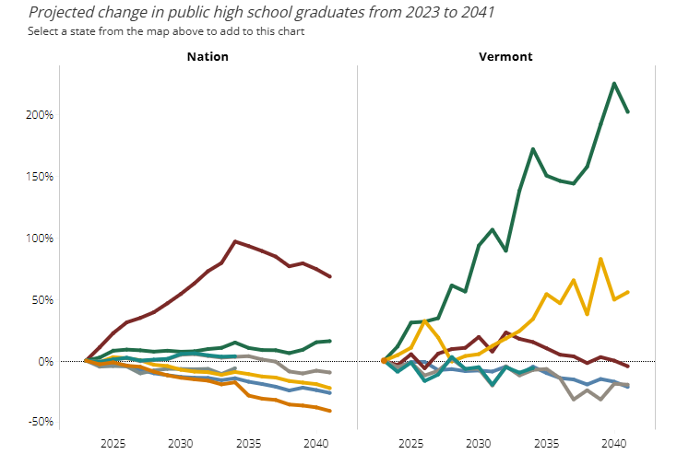
Vermont College Enrollment:
RACE & ETHNICITY
202% growth in Hispanic students!
Notes:
Vermont College Enrollment by Race & Ethnicity
Source: Vermont State Colleges, NCES, IPEDS
IPEDS Data Center: https://nces.ed.gov/ipeds/
What to Look For:
Enrollment breakdown by race/ethnicity over time.
Percentage of underrepresented students going to college.

Slide 27
Implications:
HIGHER EDUCATION
Enrollment strategies must shift to accommodate smaller and more
diverse cohorts
Implement a focus on adult learners, online education, and workforce-aligned programs
Understand the importance of financial aid optimization and
retention strategies

Slide 28
Next Steps &
RECOMMENDATIONS
Proactive institutional planning for demographic shifts
Strengthening partnerships with K-12, workforce, and community organizations
Enhanced recruitment strategies for underrepresented populations
Rethinking value propositions to meet student and employer needs

Slide 29

Cost is a key factor in school decisions
81% of families say they eliminated a school from consideration based on cost at some point between deciding which colleges to research and which to attend
In fact, 46% of families considered alternative education paths before deciding to pursue an undergraduate degree
SOURCE: How America Pays for College 2024
Notes:
When we talk about school choice, the factor that is ever-present for most families is cost, but – as you all know, and as we’ll explore in our research, cost is not the only consideration. In general, 8 in 10 college families said that they eliminated a school from consideration based on cost alone at some point between building their long list of schools and deciding which school to attend. What’s interesting, is that 61% of students and parents eliminated a school based on cost even before deciding which schools to research. Here, of course the question is what cost information are families using when they are evaluating options early on? Are they looking at cost of attendance, or are they digging deeper to understand the net price? We know from other research that many high school families don’t feel confident about the different elements and variations of school costs, and many believe that cost of attendance is what they will be expected to pay. Thus, surfacing information about college costs and average aid packages is critical to help families navigate this stage.

Slide 30
In addition to cost, location and academic programs are key for college choice
Social life, school size and prestige are secondary, but important factors for some families
SOURCE: How America Pays for College 2024
Notes:
As we said, cost is not the only deciding factor – although it is a significant one. Here, we asked students and parents to select the factors that went into their school choice decision. The bottom line is that cost, location, and a specific academic program are the top 3 factors that help most families decide which school the student will attend. These aren’t surprising – these factors are answers to the key questions families ask themselves at this stage: what will I study, where will I live, and how much will I pay. There are secondary factors that also play a role – for example, 23% of students said that friends attending a school played a role in their choice and another 18% pointed to social life. More practically, a school offering a learning experience that is online or on a hybrid schedule was a deciding factor for 19% of families. School size (being large or small) and prestige were mentioned by 15% and 13% of families.

Slide 31


The ultimate school choice factor varies by school type
Half of families who chose 2-year public schools based their decision on financial considerations
4-year private school families were more likely to make school decisions based on academic considerations
SOURCE: How America Pays for College 2024
Notes:
What we found is when it comes to the ultimate deciding factors, there are some differences by school type. Families who choose a 2-year school are more likely to consider the financial aspects (half of these families said they chose their school based on financial considerations compared to 35% overall). Then, on the opposite end of the spectrum, families who selected a 4-year private school were more likely to report that their ultimate decision was based on academic considerations (47% of them said that compared to 39% of families overall). Families who chose a 4-year public school are somewhere in the middle.

Slide 32
About half of families received the amount of aid they expected
21% received less than they expected
20% did not have any expectations
SOURCE: How America Pays for College 2024
Notes:
As we know, the FAFSA is a gateway to $114 Billion in federal aid for higher education. So how did what families received match their expectations? Well, to start with, 1 in 5 families who filed – 20% - didn’t have any expectations at all when it comes to how much federal aid they would receive. 54% of filers received about the amount they expected. 5% received more than they expected, and 21% received less than expected. In all, then, about 4 in 10 families either didn’t know what they would get OR got less than they hoped for. I view this proportion of families as those who would be most likely to scramble at that moment to try and figure out how to cover the gap.

Slide 33
26%
1 in 4 families skipped the FAFSA® for AY 2023-24
Most FAFSA® non-submitters believe their income is too high
This reason is most prevalent among families with household income of $150,000 or more (63%)
However, 25% of families earning less than $100,000 didn’t file for this reason
SOURCE: How America Pays for College 2024
Notes:
So, if 74% of families filed the FAFSA, that means that 26% did not. The main reason families didn’t file the FAFSA – and this reason has been a top one for many years of this research – is that families believe they make too much money to qualify for any aid. 33% of non-filers mentioned this reason. Now, it makes sense to me that families making a lot of money have this idea – and in fact, among non-filers making $150K or more, 63% mentioned this reason. However, 1 in 4 families making less than $100K also mentioned this reason, and this of course is a misconception. We know that most families that apply, get something.
Other reasons for skipping out the FAFSA are logistical, such as 18% not having the time to file, or 17% not having the required information, or 13% finding the application too complicated. Hopefully, as the new FAFSA settles, some of these issues will be addressed.

Slide 34

Questions
LisaBranson, enrollmentFUEL Lisa.branson@enrollmentfuel.com
Bill DeBaun, National College Attainment Network (NCAN) debaunb@ncan.org

Slide 35
Thank you from the VASFAA Engagement Membership Committee

